Slide 1
Evaluating the Effect of Induced Errors and Seeds

Slide 2
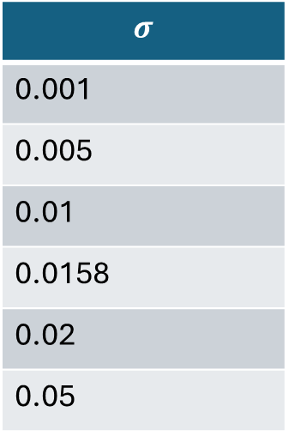

Method – Induced Error
Added a Gaussian error every 12 steps
$μ=0$
Various $σ$ used
$MAE=\sqrt{\frac{2}{π}} σ≈0.79σ$
$$σ$$
0.001
0.005
0.01
0.0158
0.02
0.05
Corresponds to the model’s MAE

Slide 3
Method – Seeds
Selected two seeds for NumPy
Affects initial Boltzmann distribution of momenta
Possibly GPAW calculations
Compare the difference between different seeds and between simulation and model.
 | Seed 1 | Seed 2
Pure Simulation | X | X
Model | X
Induced Error | X

Slide 4
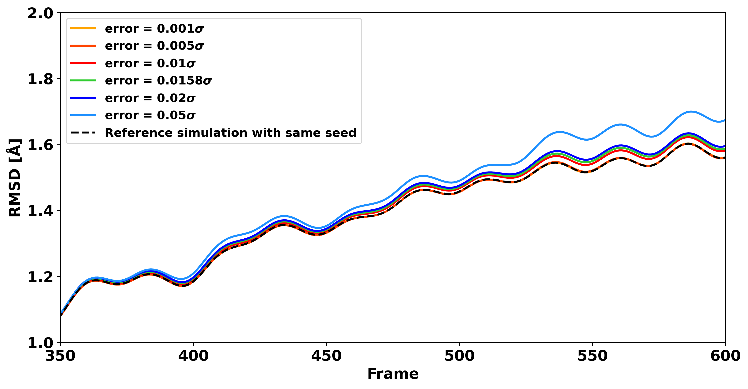
RMSD – Induced Error

Slide 5
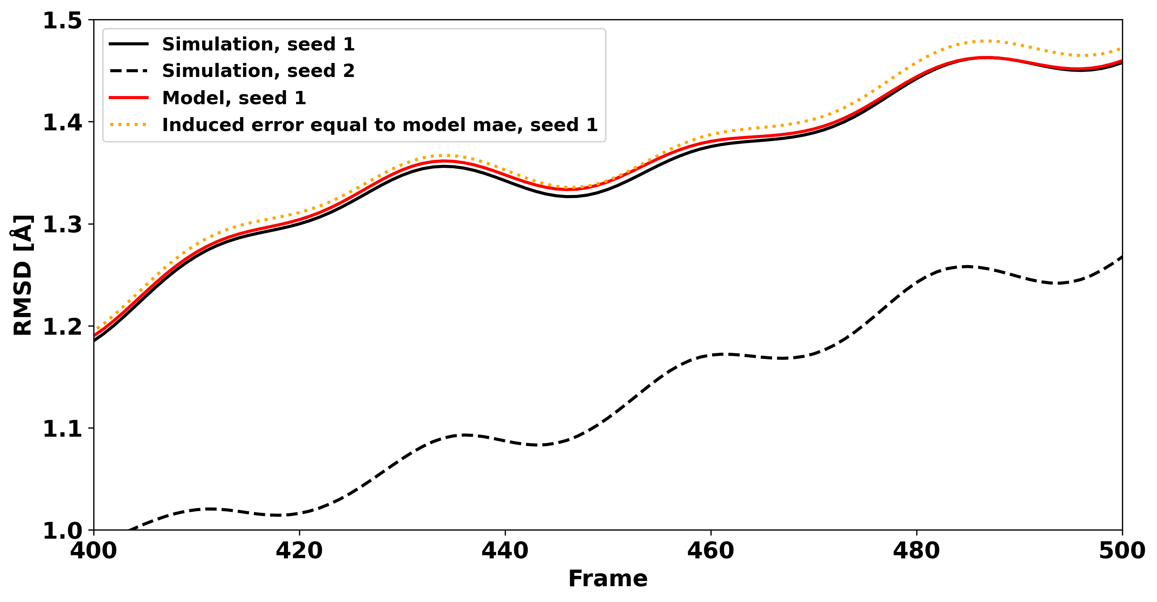
RMSD - Seeds

Slide 6
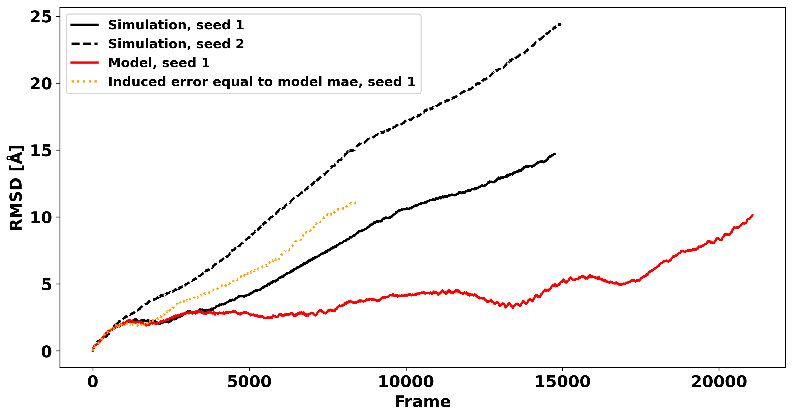
RMSD – Seeds

Slide 7
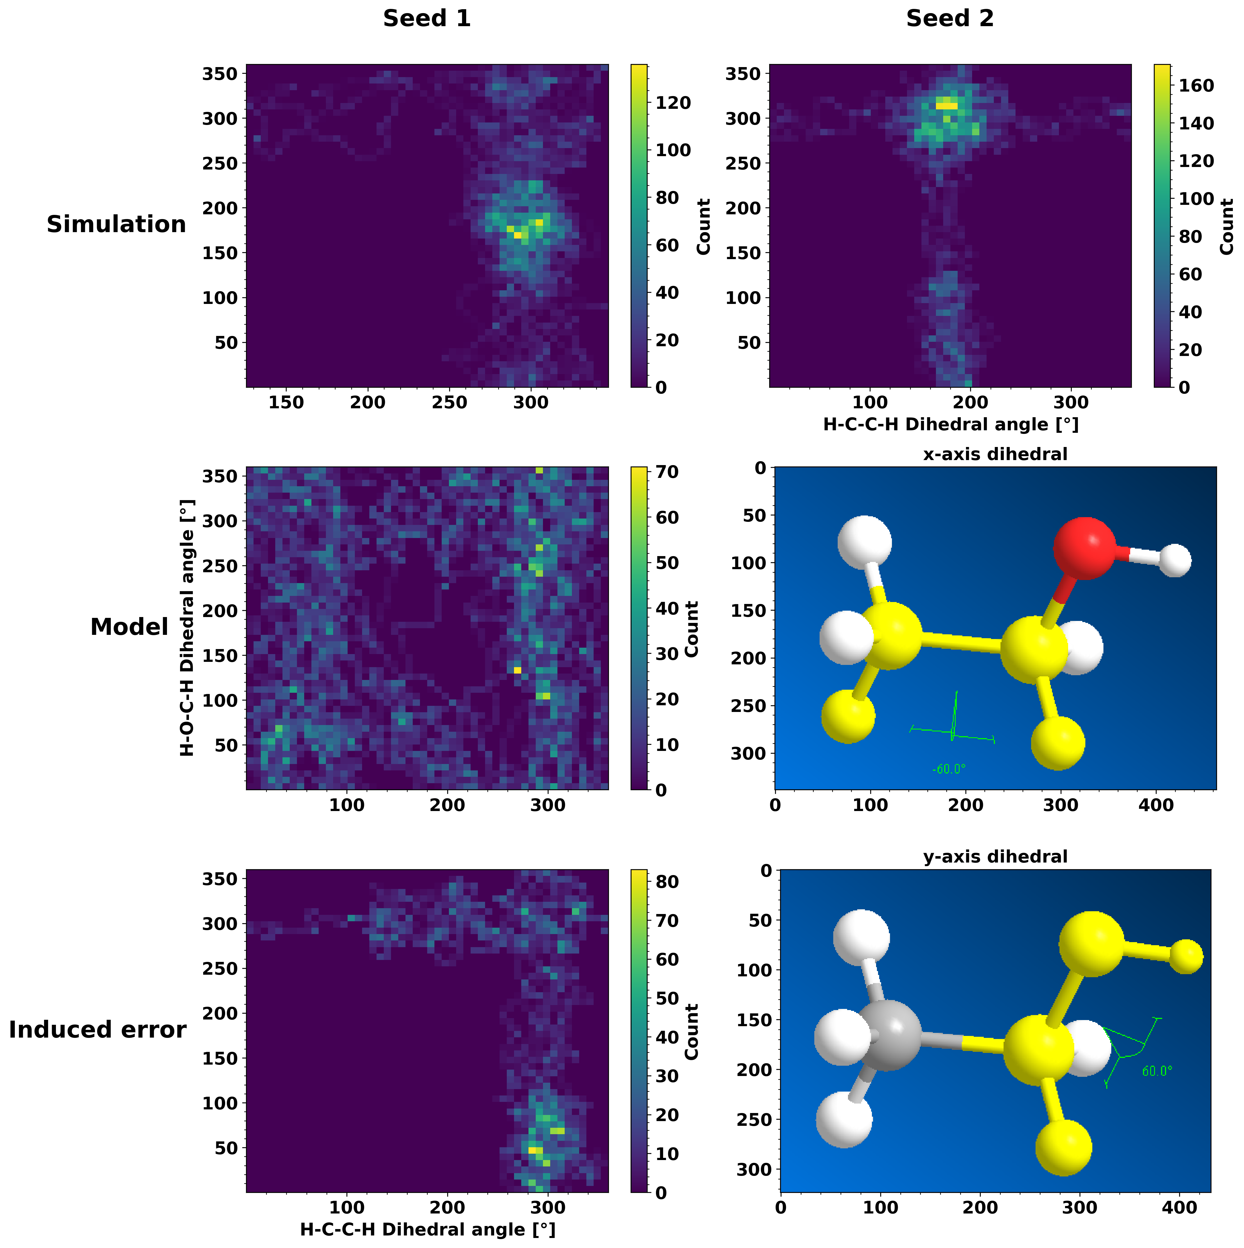
Dihedral
HCCH dihedral
HCOH dihedral

Slide 8
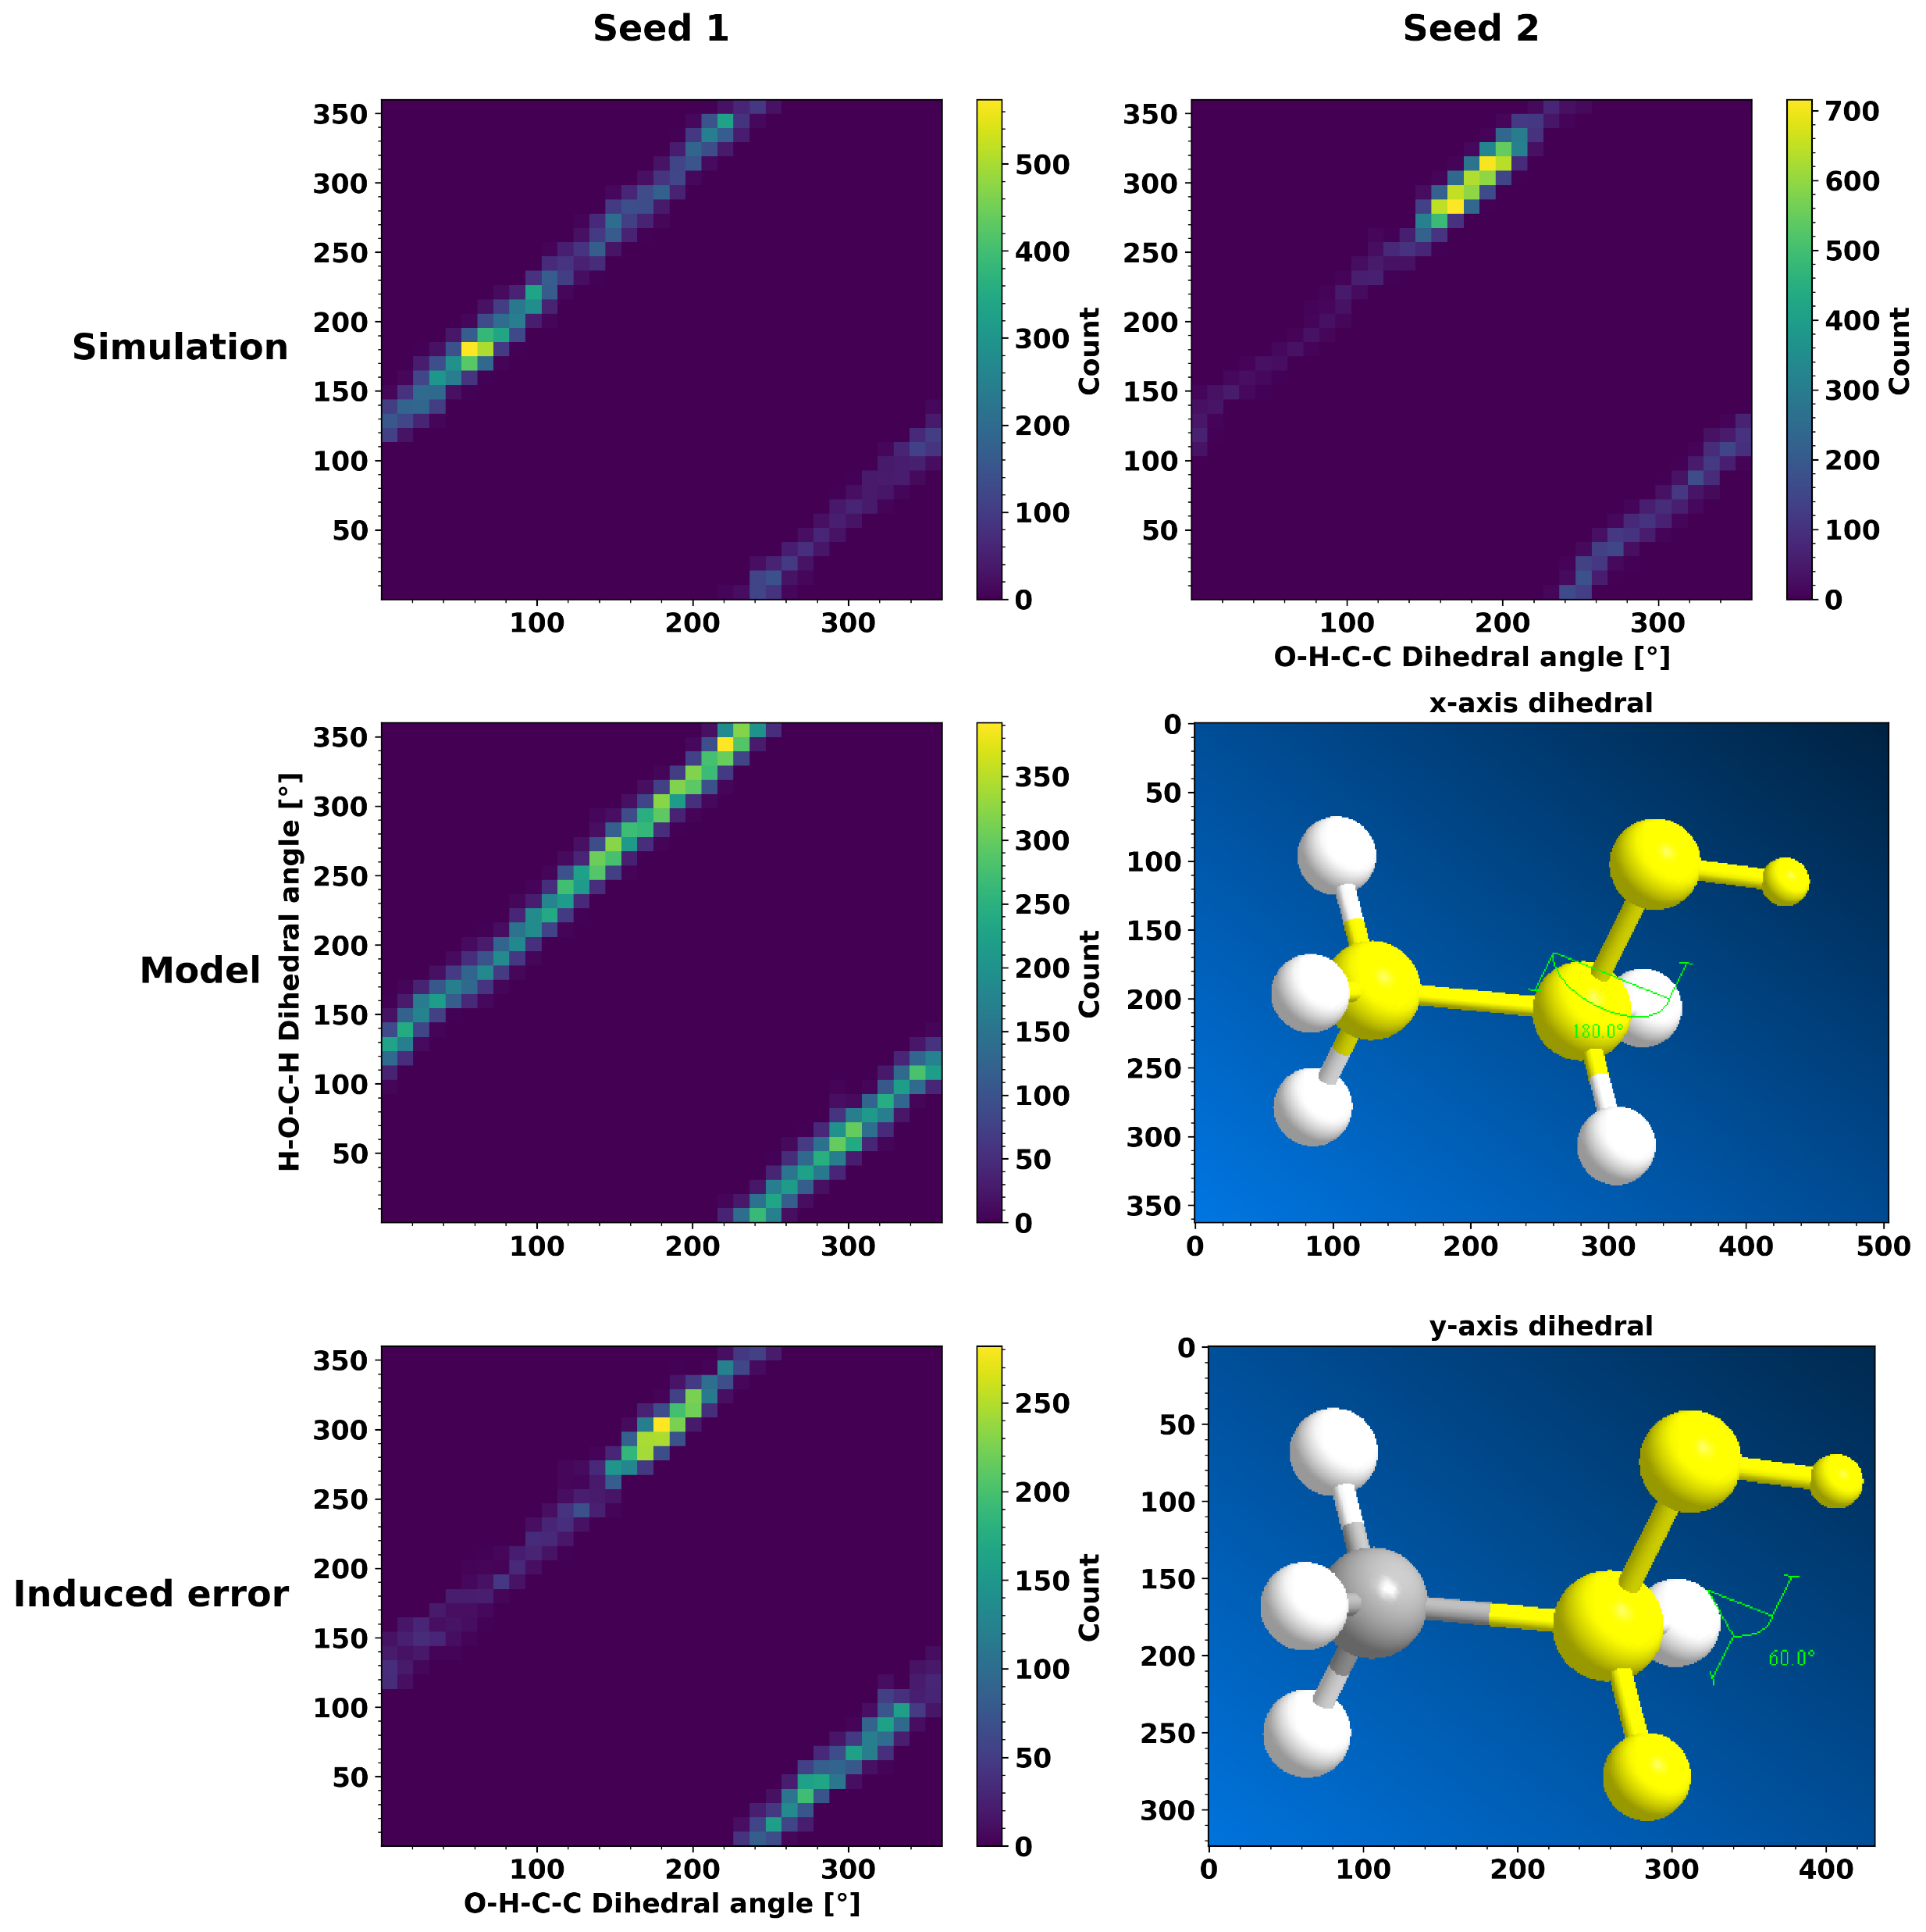
Dihedral
CCOH dihedral
HCOH dihedral

Slide 9
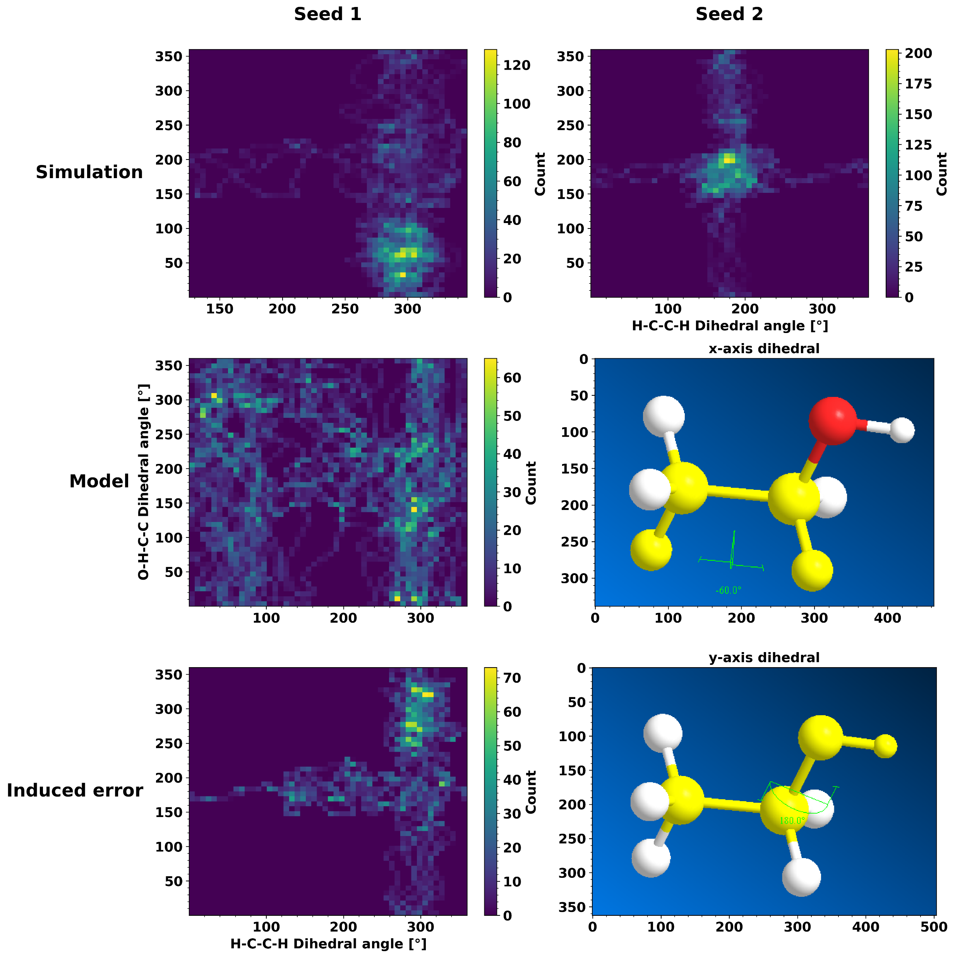
Dihedral
HCCH dihedral
CCOH dihedral

Slide 10
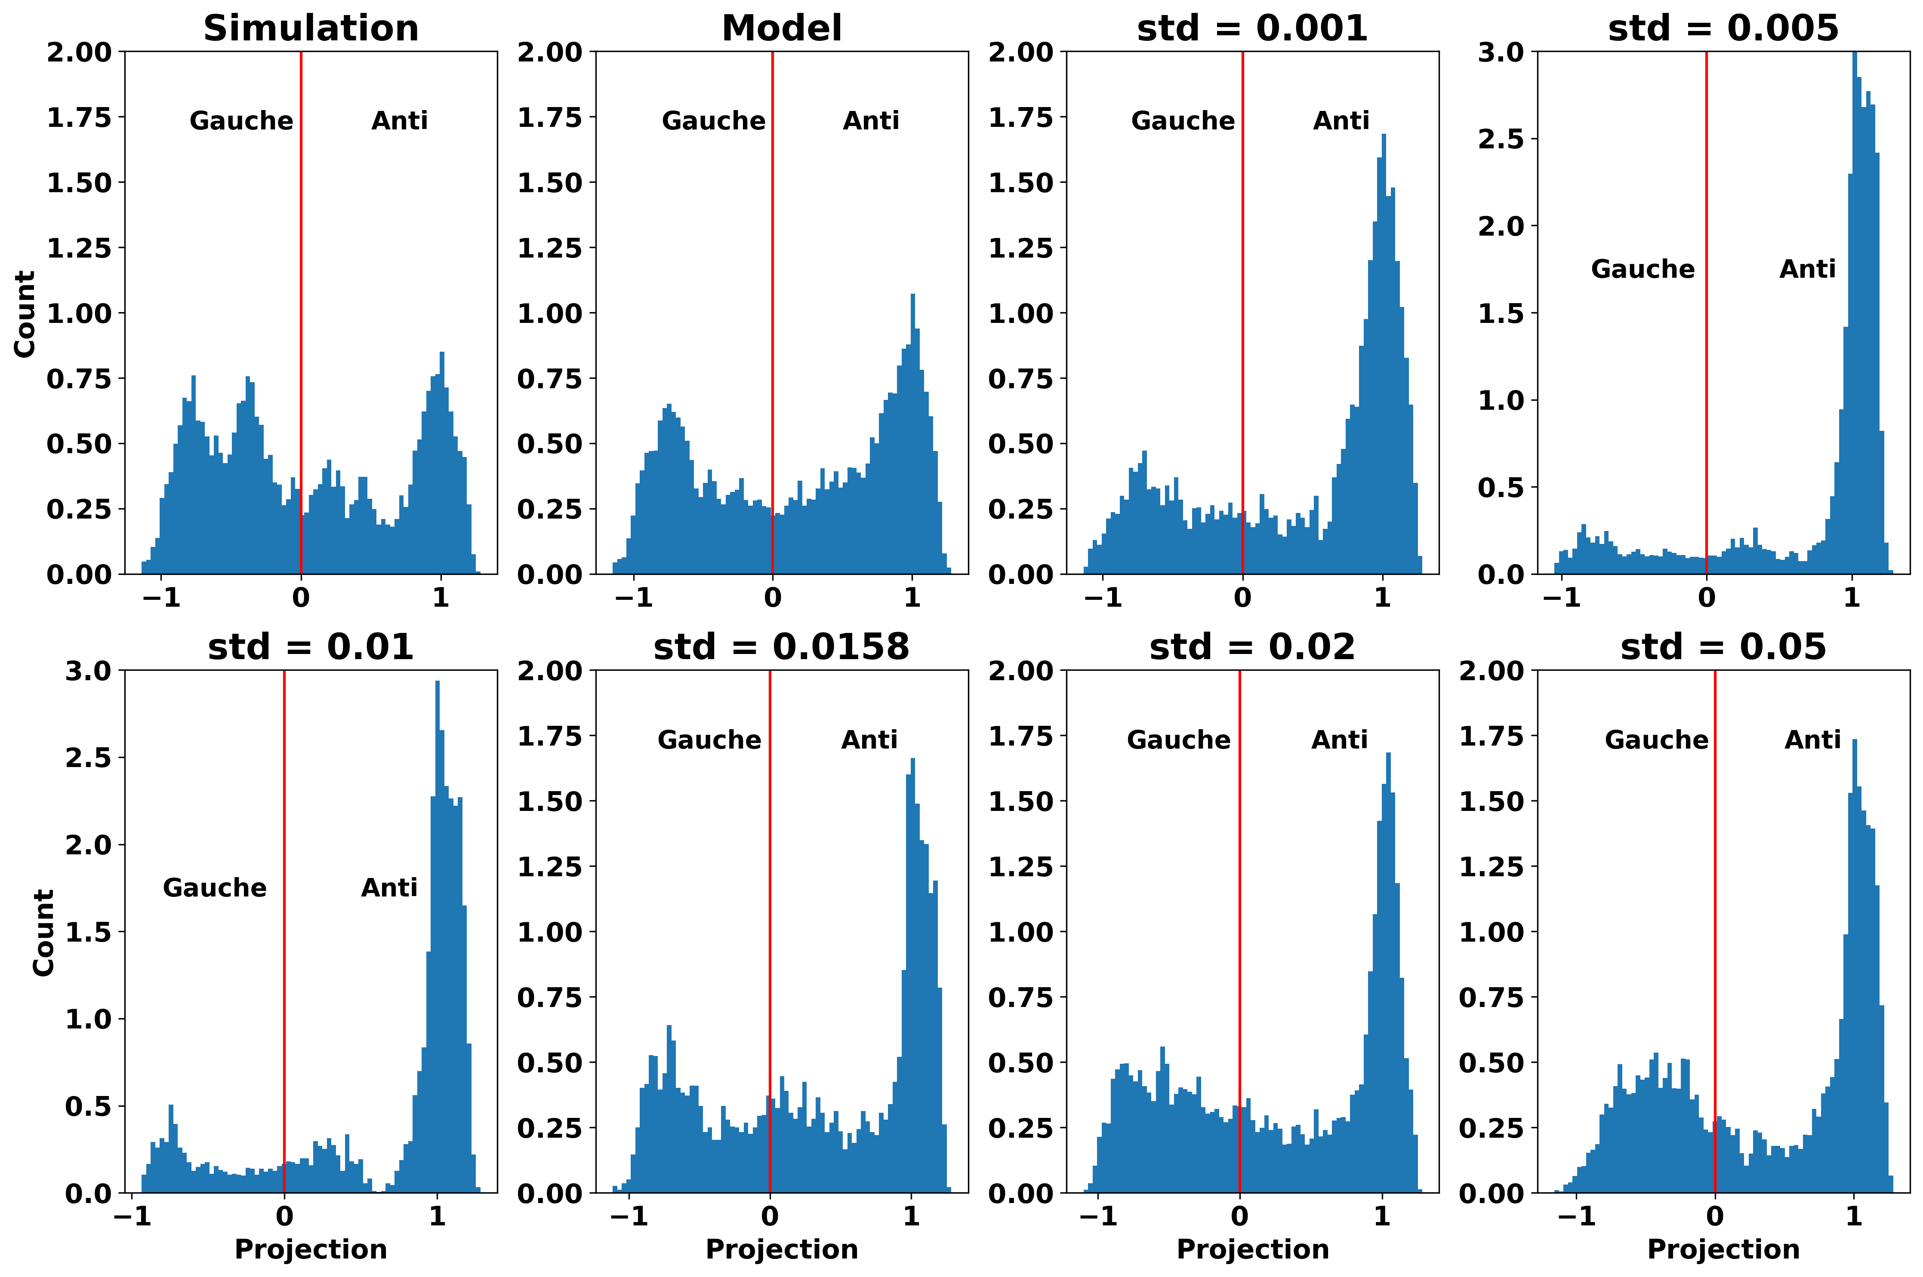
Isomers – Induced Error

Slide 11
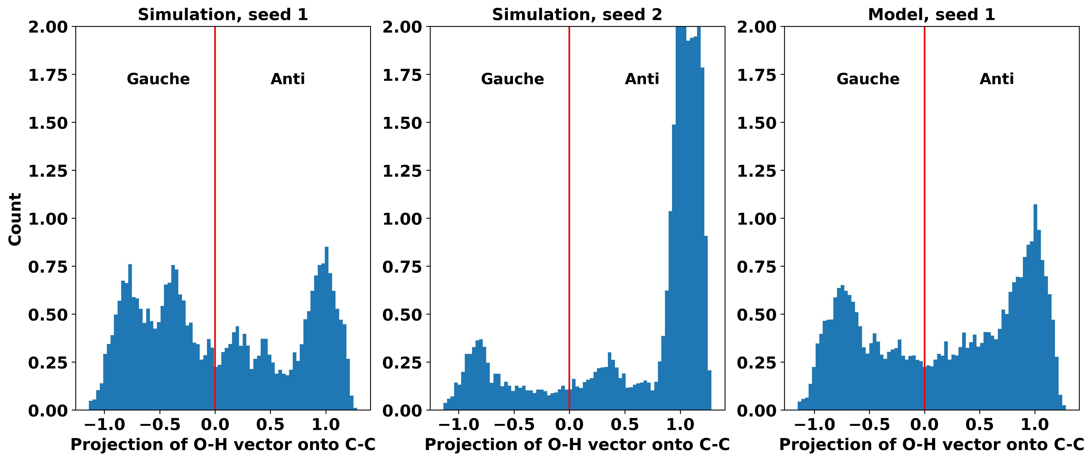
Isomers – Seeds

